Slide 1
Image analysis and data processing in superresolution microscopy 2021
Mgr. Zuzana Burdikova, PhD
Microscopy Imaging Researcher
Laboratory of Confocal and Fluorescence Microscopy
Faculty of Science, Charles University

Slide 2
The fundamental limits in light microscopy
Resolution
ability to resolve objects in close proximity
ability to observe fine details
governed by diffraction (photon is a wave) and labeling density
Signal to noise ratio
ability to observe small/faint features
strongly depends on contrast (e.g. fluorescence)
governed by photon statistics (photon is a particle)
“If it isn’t diffraction, it’s statistics!”
James B. Pawley
Notes:
Resolution and sensitivity (SNR) are two completely different things.And both of them are important to obtain high quality
microscopy images.
Fluorescence is great contrasting method, one can see single molecule, impossible with phase contrast, …
Resolution is wave properties of light.
S\N ration its limited by number of detected photons.
Both wave and particle nature of light impose strict limitations on the quality of microscopic images
governed: urcovano

Slide 3

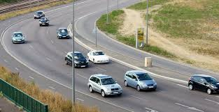
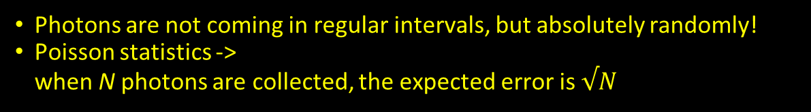
Photon statistics
Photons are not coming in regular intervals, but absolutely randomly!
Poisson statistics -> when N photons are collected, the expected error is $√N$

Slide 4
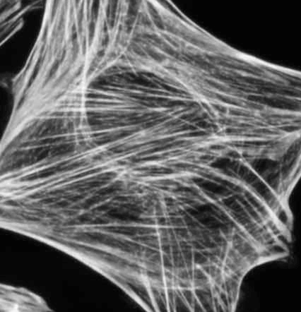
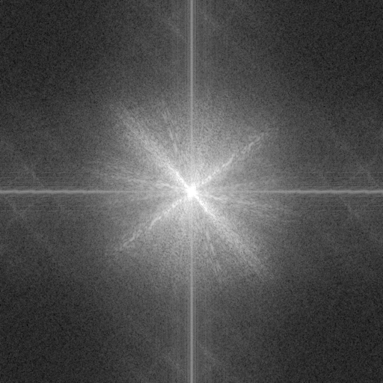
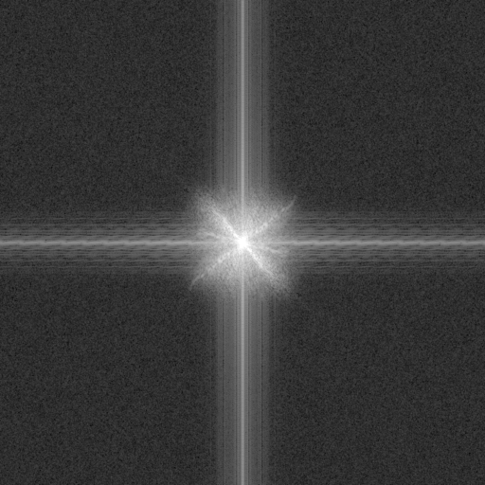
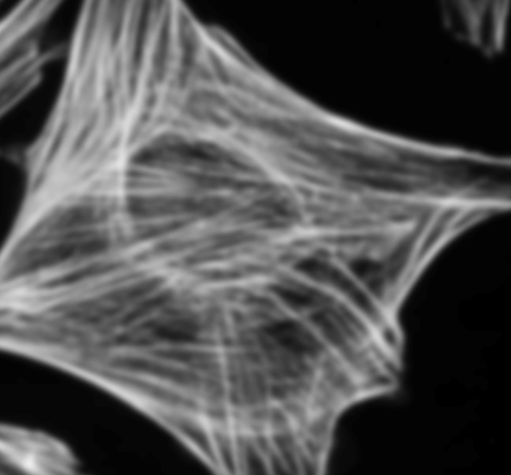
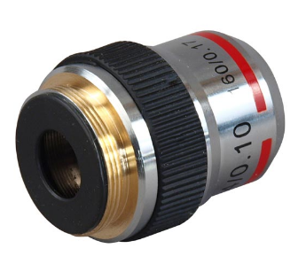
Resolution in light microscopy is
Can be understood in ”real” space or in “spatial frequency” domain using FT (Fourier transformation) (best in both :-)
Higher NA
Image information
Lower NA
low frequencies
Noise
high frequencies
BFP
Lens
Sample
given, limited by numerical aperture
cannot be arbitrarily large
NA < n (refractive index)
FT
Notes:
Various aspects of resolution in light microscopy can be best appreciated by switching back and forth between “real” image space and “spatial frequency” space using Fourier transformation.
Resolution in real space: Can I distinguish two closely spaced points or lines?
Resolution in Fourier space: Note, the FT image contains low frequencies (low resolution information) near the center and high frequencies (high resolution featires) near the edges. You’ll hear much more about FT in later talks.
In light microscopy the finite Numerical Aperture (NA) is the “hard” resolution limit - no information about features beyond the resolution limit passes the objective lens!
Fourier transformation Image is teling that : details inside the yellow ring (fourieruv obr)- have lower resolution than details outside the yellow ring ( noise
Objective with lower NA (obr v pravo_ image is more blurry - FT - uzitecne informace jsou jen uvnitr v malem kolecku
NA cannot be infinite, it is always less than the refractive index of the sample and everything between the sample and the lens.
Drawing: Model of an ideal lens - the lens actually performs Fourier Transformation of the in-focus sample. The FT appears in the Back Focal Plane (the back aperture of the objective lens). The BFP aperture limits the resolution
Kdyz je dira u objektivu mensi, tak i rozliseni bude mensi.
Protoze dira nemuze byt nekonecne velke, plyne z toho, ze rozliseni v mikroskopu je finite. - Abbes LIMIT
Proc je rozliseni konecne a co fyzicky neprkonatelna bariera.
Important: no information about features finer that the resolution limit can pass through the objective lens!

Slide 5
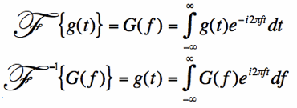
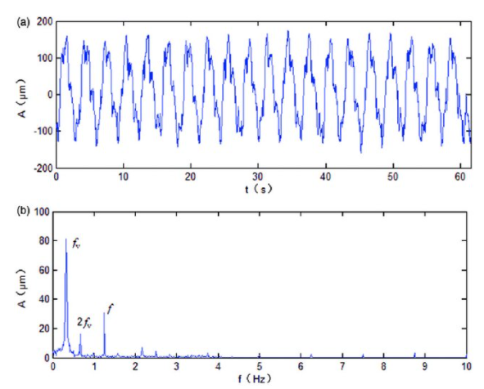

A word about Fourier Transform
Linear, complex integral transform
$e^{ix}=\cos{x}+i\sin{x}$
Link between intensities (e.g. acoustic pressure) and frequency content (spectrum)
Notes:
Linear = it has some useful mathematical properties (e.g. additivity: adding signals = adding spectra)
complex = real + imaginary part (in terms of 1D signals = amplitude + phase)
Any signal can be created using just a combination of pure sine waves...

Slide 6
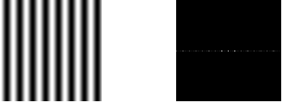
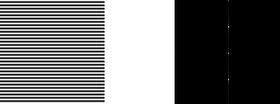
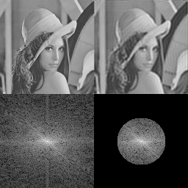

A word about Fourier Transform
Works in multiple dimensions, too $ℱ\left\{g\left(x,y\right)\right\}=G\left(k_{x},k_{y}\right)=\iint{g\left(x,y\right)e^{−i2π\left(xk_{x}+yk_{y}\right)}ⅆxⅆy}$
vlabs.ac.in
Notes:
in 2D: We talk about “spatial frequency”, a pitch of a repetitive feature in the images.
Just like with 1D signals (e.g. sound), any image can be created combining sinusoidal patterns.

Slide 7
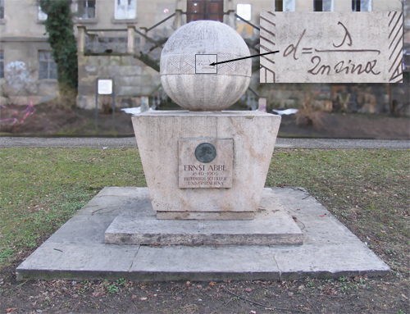




Resolution in light microscopy
Can be understood in ”real” space or in “spatial frequency” domain (best in both :-)
Image formation:
replace each point of the object with PSF (point spread function)
of the microscope
(typically an Airy pattern)
d_{min}
Ernst Abbe (1873):
Notes:
In real space …
Real Space representation
rozliseni je nizke - nerozpoznam 2 tecky
kdyz je hranicni, asi vim, ze jsou tam 2 tecky
vysoke rozliseni, rozpoznam 2 tecky
abbeho formulka na rozliseni dmin- nejmensi vzdalenost, kdy rozpoznam 2 tecky (rozliseni)
lanbda- vlnova delka , 2NA numericka apertura
PSF - rozmazane kolecka, jak vypada tiny fluorescent spot looks like through microscop

Slide 8
Superresolution light microscopy - methods
Various attempts to overcome the Abbe diffraction limit
Linear methods – “structured” illumination (Intensity (I) of emission is linear to I of excitation)
Confocal -> OPRA/ISM/ReScan -> Airyscan
InstantSIM, MSIM, SoRa
SIM, Lattice SIM
max. increase of resolution 2x
Nonlinear methods (unlimited increase of resolution)
STED, SSIM
higher resolution information can be extracted (more phases needed)
Stochastic methods (based on random blinking of molecules)
SMLM (PALM, STORM, …)
BALM (DNA-PAINT, IRIS)
SOFI, SRRF
Notes:
supeeresolution methods can be divided based on physical principles they exploit
BALM = binding assisted localization microscopy
Note, 4PI does not overcome the diffraction limit, the NA is just larger. Also, Expansion Microscopy (ExM) does not overcome diffraction
Linearni metody
znamena, ze intenzita emise je primo umerna intenzite excitace
s konfokalniho proncipu vychazi metody : OPRA - optical photon reassignment - theoretical -like irscan ( collin Sheppard)
ISM- camera misto PMT v confokalu
RESCAN- confokal, kde scanuji emisi, kde je teck stacionarni- 2 scaneery za sebou a misto PMT pouzivam kameru
Airyscan- misto 1 PMT je v konfokalu 32 PMT na unorovni pinholy nahustenych vedle sebe
-kazde PMT snima obraz skrz mirne posunutou pinholu a mtematickym zpracovanim dostaneme obraz s vyssim rozlisenim
Instant SIM, MSIM, SORA- konfokaly promitaji 1 tecku na vzorek a snimaiji 1 tecku na vzorek, tyto metody promitaji tisice tecek na vzorek a a snimaji tisice tecek kamerou
SORA - microlenses jsou na spinning disku - spinning disk s vylepsenym rozlisenim
SIM- promitam ryzne carky, ruznymi uhlu a data jsou nasledne zpracovanu FT
Lattice SIM - u norm sim jsou to cary prez vzorek, ale u Lattice SIM honeycomb structures
LINEARNI METODY, rozliseni se vylepsuje max 2x!!!!!
NOn Linearni metody - mohou vylepsivat rozliseni neomezene
STED - confocal system where extra depletion laser shrinks the excitatio PSF
SSIM - saturation SIM - when fluorophores in sample get sturated by the SIM patern , higher resoulution information can be extracted
( more phases needed)
Stochasticke metody
are based on random blinking of molecules
SMLM - single molecule localisation microscopy
dalsi zkratky to same , jen s jinym nazvem - stejny princip (PALM - photoactivated localisation microscopy, STORM - stochastic
BALM - binding assited localisation microscopy, molekuli si plavou v zorku a pokud se navazou, zastavi se a ja je vidim jako zablesk
DNA- Paint - sekundarni protilatka je navazana na kratky usek DNA a pak do vzorku pustim fluorescencni molekulu navazanou na jiny kratky usek DNA a tyto kousky DNA jsou si komplementarni a po navazani se molekula zastavi a ja ji uvidim ( nejlip funguje v TIRF)
SOFI, SRRF - methds, where individual blinking molecules cannot be resolved, high resolution information is extracted from fluctuations

Slide 9
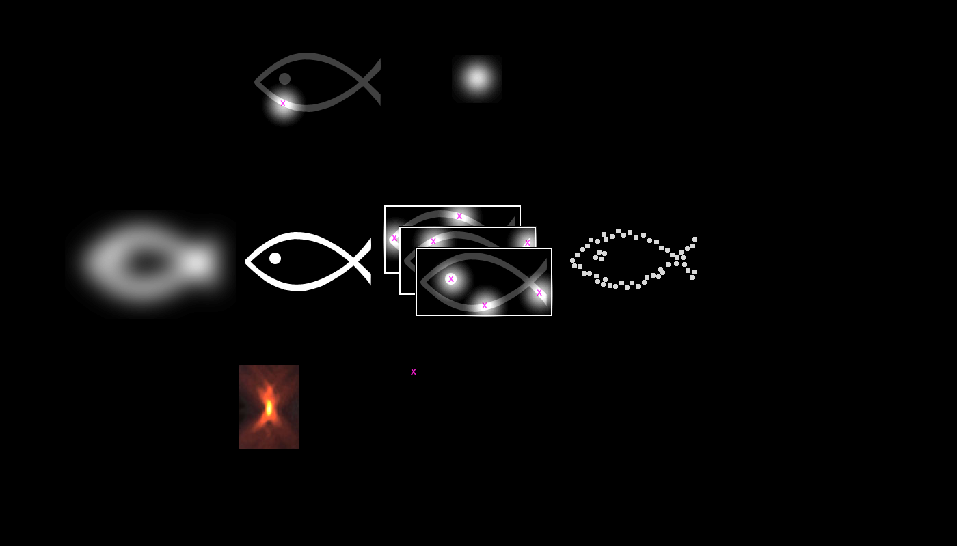
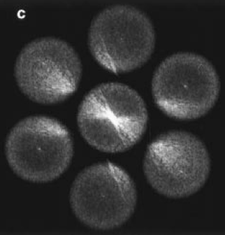
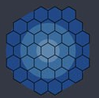
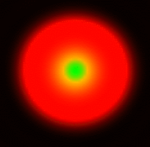
Superresolution light microscopy - history
STED
SMLM
SIM
confocal / Airyscan
Einstein 1917
stimulated emission
theory
????
related to confocal,
axially modulated excitation
Minsky 1955
LASER 1960
Petran 1966
Moerner 1989 (@ 4 K)
Sheppard 1988
(concept)
Bertero
1987 –
1992
Hell 1994 (concept)
Cremer 1998
Hell 2000
Gustaffson 2000 (†2011)
PALM
Betzig 2006
STORM
Zhuang 2006
Leica
2007
Nikon, Zeiss, Vurata, …
2010
Nikon, Zeiss, GE…
2010
Enderlein
2010
Abberior
~2013
Sheppard 2013
Zeiss Airyscan 2015
SoRa 2018
Notes:
Historical overview
STED - Einstein vymyslel teorii laseru a neslo to experimentalne overit, HELL - v 94 vsiml, ze by to slopuzit na superres
Interestingly: STED very technically challenging, but with the help od Stefan Hell’s dedication, it was developed in just 13 years from the first concepts
On the other hand, SMLM, quite trivial from the technical standpoint, took longer to develop
Moerner : pozoroval jednolive molekuly a jejich fluorescenci ( nobel prize) pozoroval to pri 4K ( 4 kelvin- nizke teploty)
SIM … commercialized 12 years from first demonstration,
Airyscan – superresolving properties of confocal were apparent early on, “pinhole plane imaging” suggested 1987-8. Even though the 32-channel detector (now used for Airyscan) appeared in commercial confocal microscopes in 2001, it took 10 more years to revive interest in this method!
Minsky, Petran - spinning disk , pak Sheppard concept ) - az po publikovani Enderleinem se veci zacali hybat a komercializace v roce 2015 , 2018 ( yokogava sora)

Slide 10
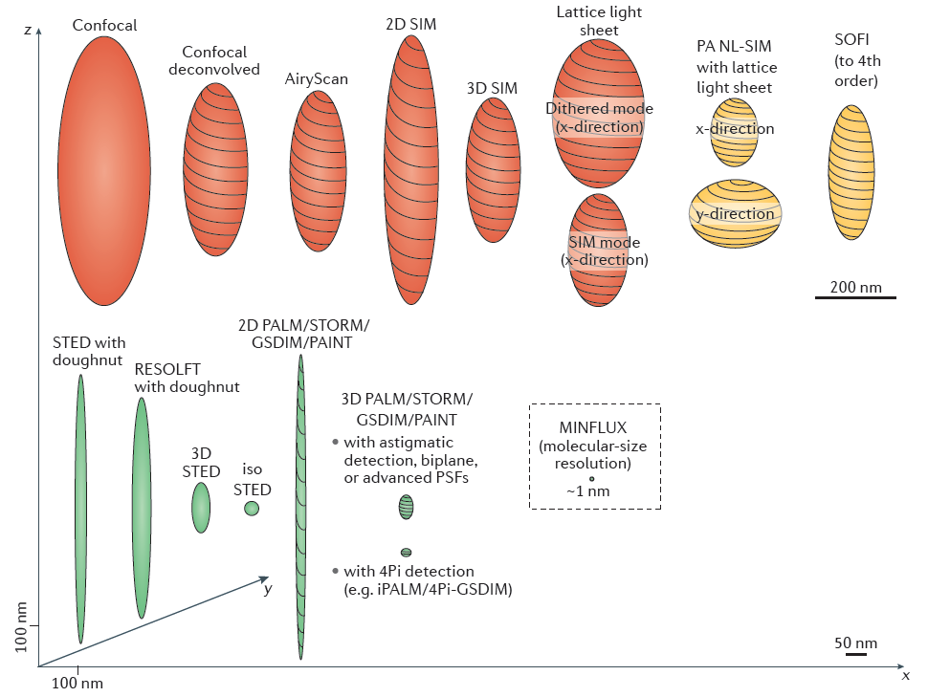
Superresolution light microscopy – comparison of resolution
Nobel prize 2014:
Eric Betzig,
Stefan W. Hell,
William E. Moerner
Ellipsoids of resolution in XYZ
from Steffen, Stefan and Stefan, Nat Rev. Mol. Cel. Biol. 18 (2017) 685
Notes:
… from a recent review by Steffen, Stefan and Stefan (yes, one of them is S. Hell)
resolution of superresolution methods, the “confocal” is NOT the superresolution version
SMLM methods appear very attractive here…
Elipsoidy, ktere zobrazuji rozliseni pro rodilne mikro tech
SIM - je 2x lepsi ve vsech 3 smerech
STED - standartni na dobre rozliseni v x,y, a v z ma obycejne rozliseni 3D sted je tak lepsi
PALM\STOPM je teoreticky nejlepsi
Stom metody vypadaji, ze maji velke rozlise a jsou jednoduche na hardvare a dosahuki velkmi dobrejho rozliseni.

Slide 11
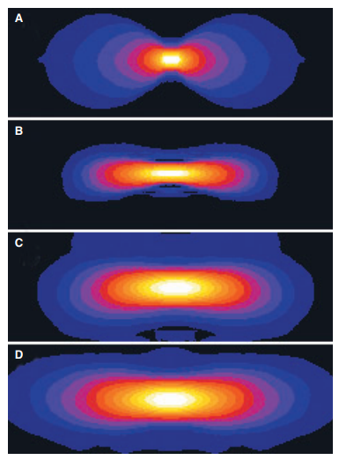
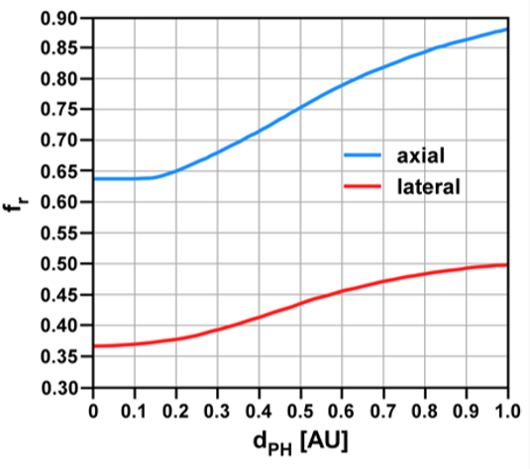
Confocal – is it superresolution technique?
OTF (Optical Transfer Function) = Fourier Transform of the PSF (Point Spread Function)
Theoretically … yes!
Widefield
Confocal, 4.3 AU
Confocal, 2.5 AU
Confocal, 0.7 AU
Axial and lateral resolution of a confocal microscope improves with smaller pinhole (below 1 AU)... … but the signal decreases quickly!
Peter Shaw, Pawley’s Handbook, chap. 23
Ideal microscope: resolution of a small pinhole & light collection of a large pinhole!
Notes:
In principle, point-scanning confocal uses the ultimate structured illumination – just a single point. Unfortunately, regular confocal does a poor job extracting the superres information…
OTF (Optical Transfer Function) = Fourier Transform of the PSF (Point Spread Function)
OTF - larger extent means higher resolution
The idea is: An ideal confocal microscope would have the resolution of a small pinhole and light collection efficiency of a large pinhole - that’s exactly what Airyscan is trying to achieve!
graf - jak se meni rozliseni, kdyz zmensuji pinholu, ze vidim, ze na 1 airy unit, tak mam rozliseni, a kdyz zaviram pinholu k nule, tak se zvysuje rozliseni
zvysuje se both lateral and axial resolution
confokal sam o sobe je superrezolucni metoda, zaviranim pinholy zvysim 2x rozliseni , ale problem je, ze kdyz zavru pinholu, tak nic nevidim

Slide 12
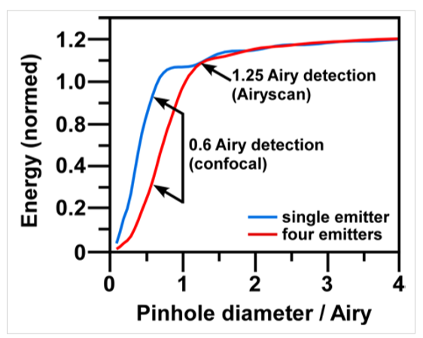
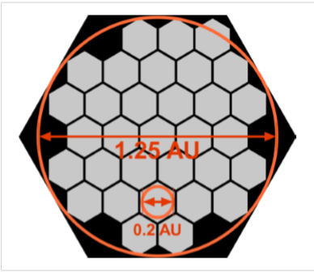
Confocal – is it superresolution technique?
Practically… not so much!
… solution: Airyscan …
Amount of light that passes through the pinhole
32 channel area detector collects a pinhole-plane image at every scan position. Each detector element functions as (0,2 AU) pinhole.
The 32 detectors combine to a total pinhole size of 1.25 AU
ZEISS application note
Airyscan: resolution of a small pinhole (0.2 AU) & light collection of a large pinhole (1.25 AU)!
Notes:
The reason is the fast drop in fluorescence intensity with closed pinhole.
Airyscan is one of the linear superresolution methods that allows increased resolution in a confocal microscope...
Airy scan funguje, jako by byla mala pinhola, ale zachovava signal.

Slide 13
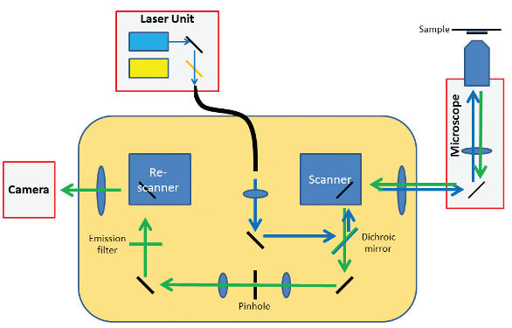
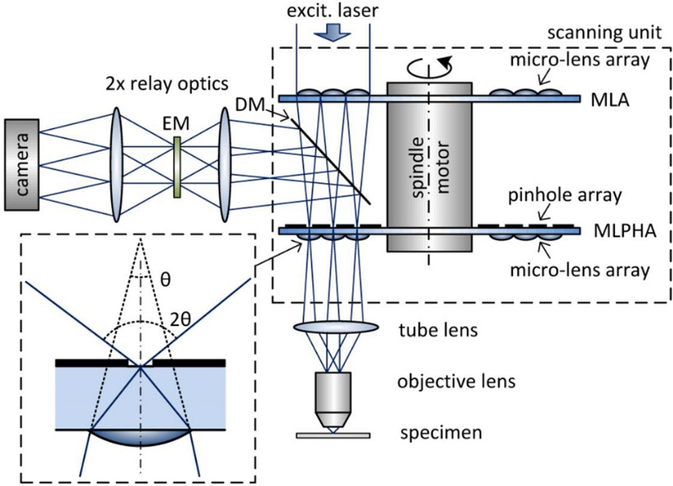
“Photon Reassignment” methods
Linear superresolution methods based on the same “Photon Reassignment” principle:
Spinning disk with extra microlenses
ReScan confocal
AiryScan
SoRa
Cheap and easy to operate
Basic 4-color confcal
Relatively slow (0.25 fps)
point scanning confocal with second set of XY galvos that re-scans the signal onto CMOS camera
Easy to operate
Flexible confocal microscope
Advanced image processing
based on computer processing
Cheap and easy to operate
Fast (it’s spinning disk)
Less superres
spinning disk with extra microlenses
Notes:
ReScan, Airyscan, SoRa - linear superresolution methods based on the same principle.
ReScan and SoRa perform the “image processing” using optics, Airyscan uses computer processing.
ReScan : point scanning confocal with a second set of XY galvos, that “re-scans” the signal onto a CMOS camera. Synchronized scanners and precise magnification adjustment performs the superresolution “image processing” optically. Cameras also have better quantum efficiency than photomultipliers.

Slide 14
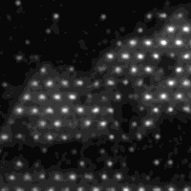
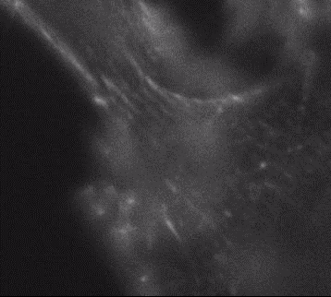
SIM
Resolution improvement dictated by the spatial frequency of the illumination features
SIM projects line patterns with different angles and phases (or thousands of dots) and processes the camera images by FT
“Lattice” style
-honeycomb structure projected across the sample
“Traditional” style
- lines projected across the sample
Fourier domain processing
Notes:
If we could illuminate lines 10 nm apart, we would get 10 nm resolution. But we can’t!
konfokaly promitaji 1 tecku na vzorek, ale tyto metody promitaji tisice tecek na vzorek a snimaji tisice tecek kamerou

Slide 15
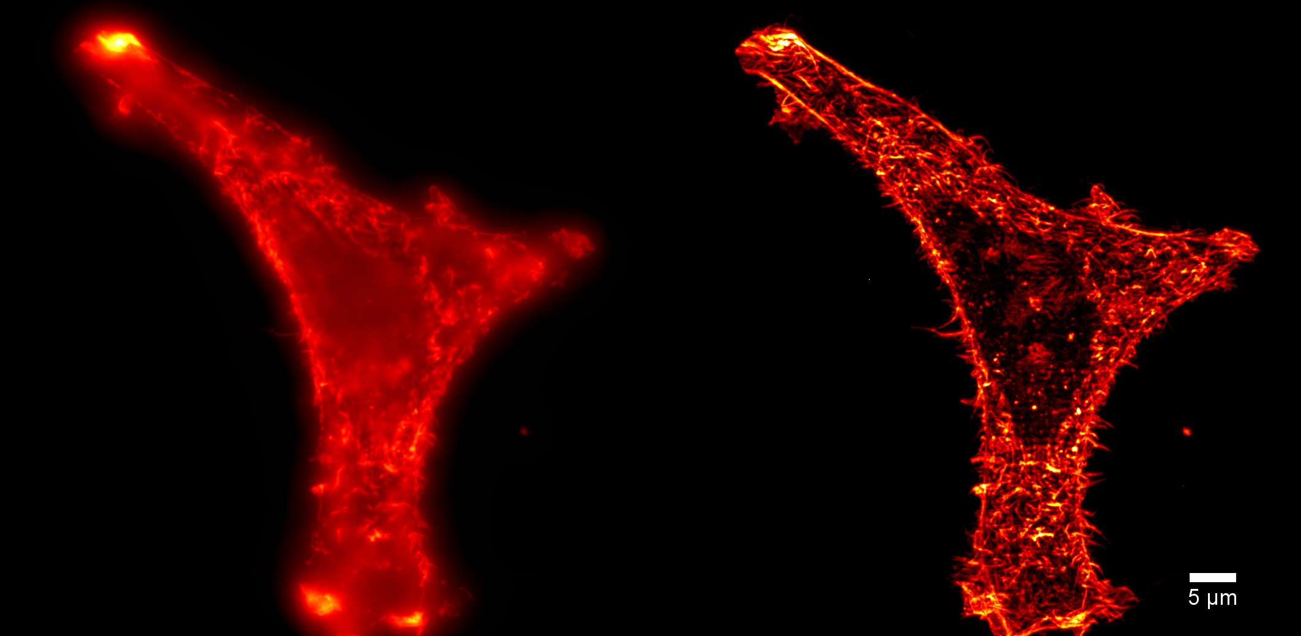
2D SIM
Pavel Křížek and Guy M. Hagen
Notes:
One of the unfair comparisons – widefield vs optical-sectioning!

Slide 16
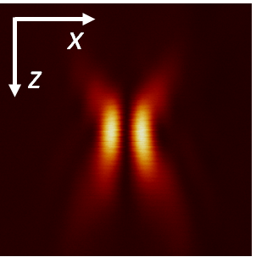
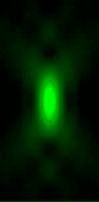
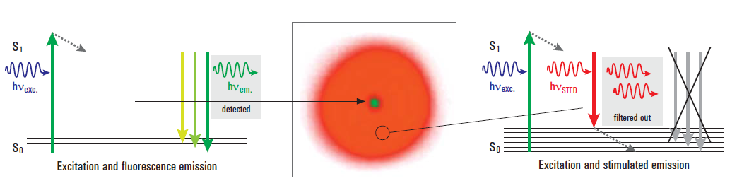
STED – CLSM with extra depletion beam
Confinement in z also possible
Objective
+
=
confocal excitation PSF
STED beam (doughnut)
PSF (no light in the middle)
effective excit ation PSF
Molecule is de-excited by the STED beam, and does not contribute to the fluorescence signal
Comparison of some common superresolution techniques:
XY projection
592 nm fiber laser, 600 mW
Notes:
It’s a point-scanning confocal with extra Depletion beam (very strong, pulsed) overlapping with the excitation beam.
The STED beam PSF is doughnut-shaped (created using a special vortex phase plate), and it has zero (no light) in the middle.
The STED beam depletes some of the excited molecules, leaving only the ones in the central “zero” - this results in much narrower effective excitation PSF.
Normalne excitace v zelene - emise zluta, ale pri STEDu je stimulovana emise cervena.
Molekula, kdyz ma okolo sebe hodne cervenych fotonu, tak vyzari cerveny foton.. ..deplecni lase zpusobi, ze zacne zarit cervene
More than 5x resolution improvement is routinely achieved.
Jablonski diagram …

Slide 17
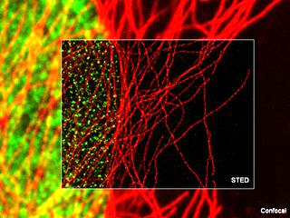
H3, tubulin (YFP), live cells, Dr. Yasushi Okada, University of Tokyo.
Notes:
example: histone H3 ( zluty , YFP) and tubulin

Slide 18
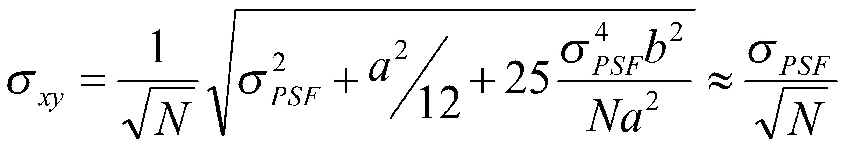
Single Molecule Localization
STORM, PALM, …
based on blinking of individual molecules
“photonic” background
widefield (Abbe) “resolution”
pixel size
number of “captured” photons
number of captured photons
widefield
sample
image series
reconstruction
Notes:
the principle
sigma - presnost lokalizace molekuly
N - pocet fotony, ktery z molekylu zachytim
a - velikost pixelu
b- pozadi ( sum)
N.a - pocet fotonu x velikost pixelu
odmocniva – square

Slide 19
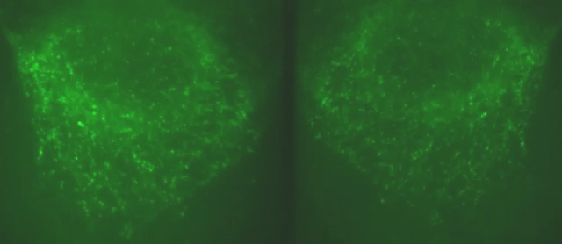
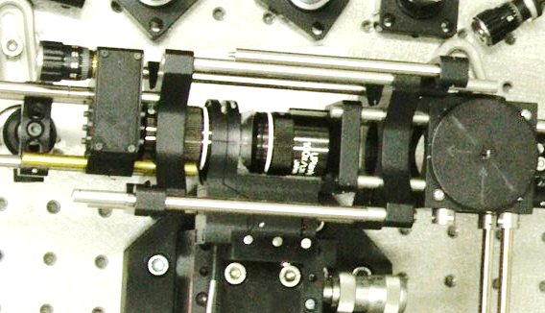
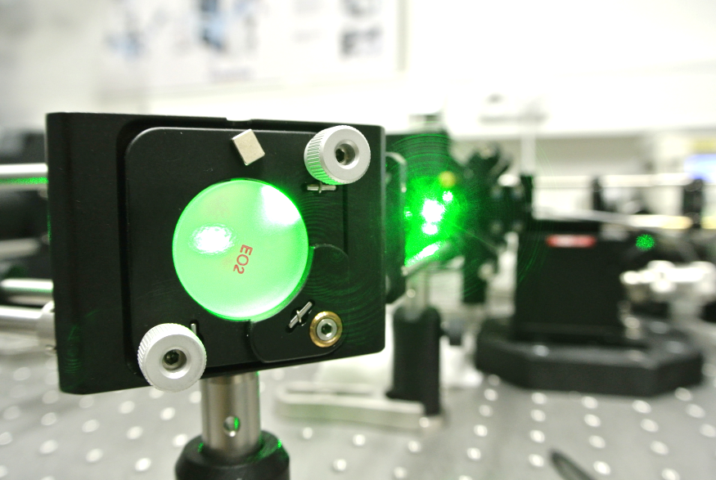
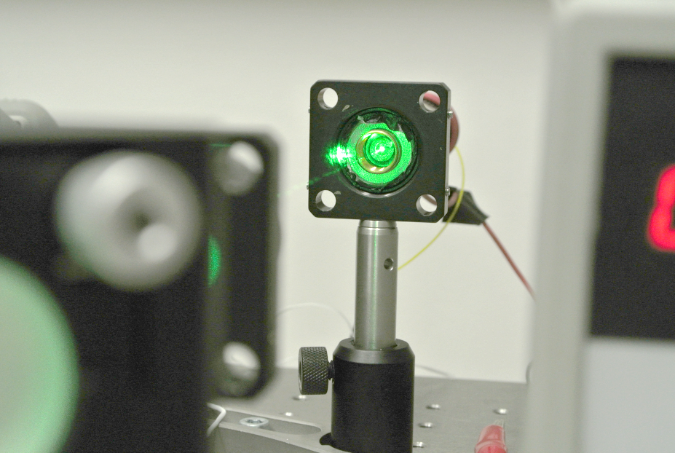
Single Molecule Localization
Key features:
Powerful illumination
Fast, sensitive camera
Isolated blinking
Low background
High label density
Long acquisition
3D is a bit tricky
Notes:
key requirements…
Technology is mature enough (e.g. back-illuminated SCMOS cameras)
Sample preparation and fluorescent labeling strategies keep improving

Slide 20
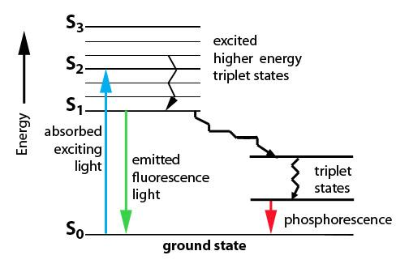
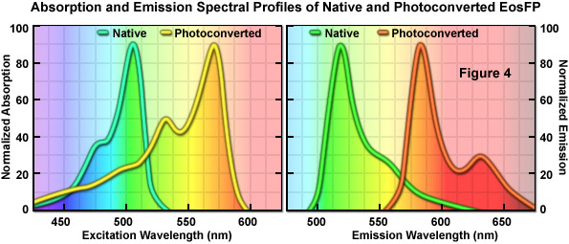
Stochastic fluorophore blinking
Common Cyanine, Rhodamine dyes
- special ‘blinking buffer’ stabilizes dark state
- typically thiols + oxygen scavengers
- require very intense illumination
- ≈10,000 photons per burst
singlet
chemically bound dark state
Photo-switchable proteins
- mEOS, CFP, … - no special buffers needed - moderate light intensities
- live cell imaging demonstrated
Transient binding of fluorophores = BALM
Notes:
key features

Slide 21
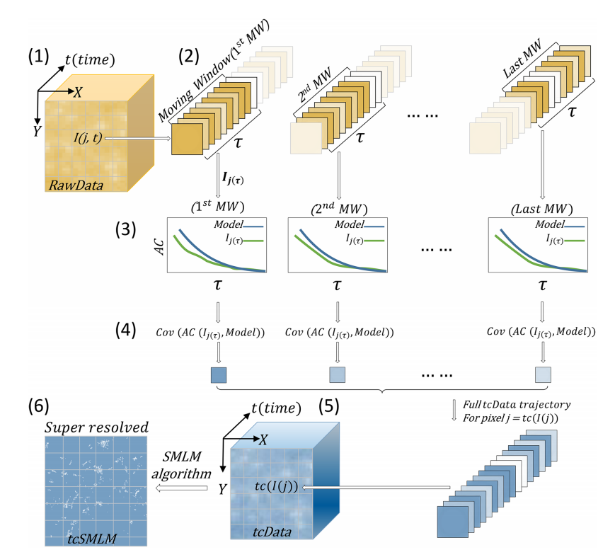
A significant improvement: tcSMLM
“time-correlated Single Molecule Localization Microscopy”
Harnessing the temporal properties of the blinking fluorophores
Frames are not processed separately, but in groups ( < 50 frames)
The autocorrelation of the temporal profile of each pixel is compared to a model
The last step is ThunderSTORM...
Hermon et al. Time-correlated single molecule localization microscopy enhances resolution and fidelity. Sci Rep 10, 16212 (2020).
Notes:
Basically it’s a very clever pre-processing of raw images

Slide 22
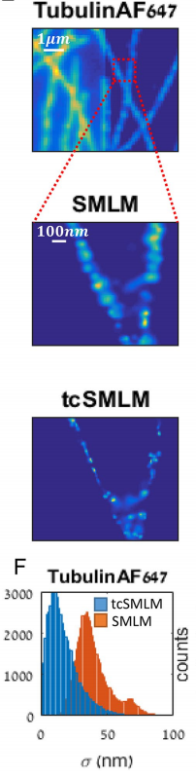
A significant improvement: tcSMLM
Especially useful with fast frame rates ( > 100 fps)
Typical resolution improvement: 50 nm -> 30 nm
Matlab code available https://github.com/ShermanLab/tcSMLM
Processing is slow, but can be parallelized...
Hermon et al. Time-correlated single molecule localization microscopy enhances resolution and fidelity. Sci Rep 10, 16212 (2020).

Slide 23
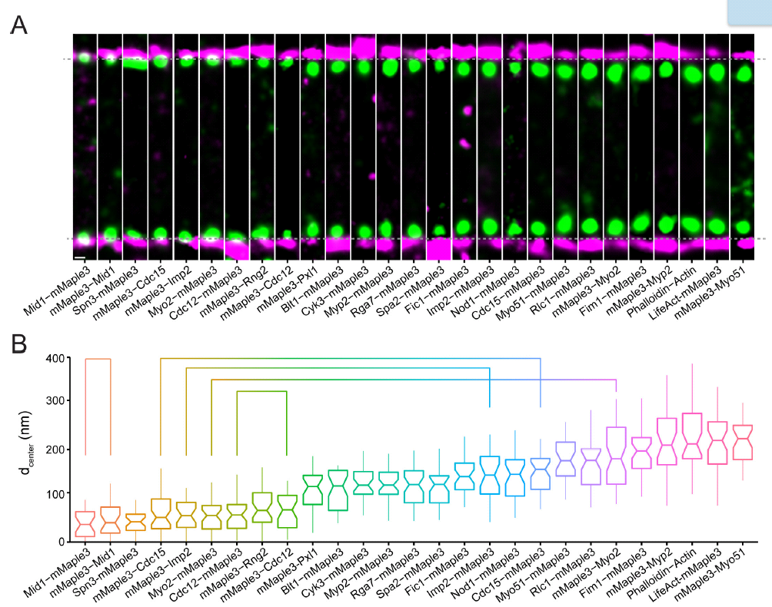
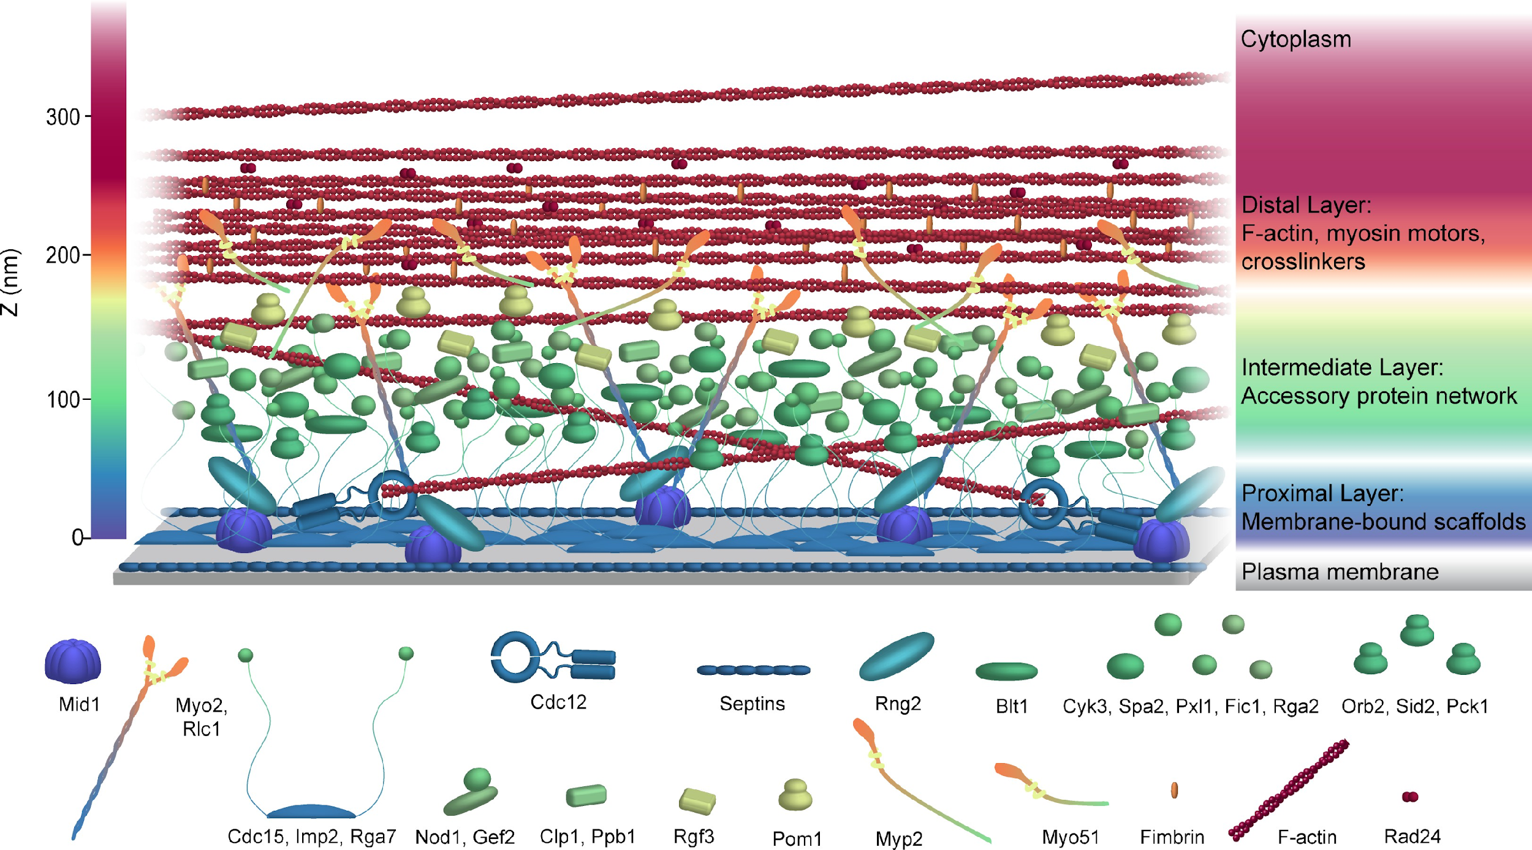
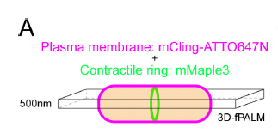
SMLM Application: yeast contractile ring - search for proteins localisation
Some ~ 38 proteins
McDonald et al, Elife. 2017, 6. pii: e28865
Notes:
Example: S Pombe
Vanderbilt University, Nashville

Slide 24
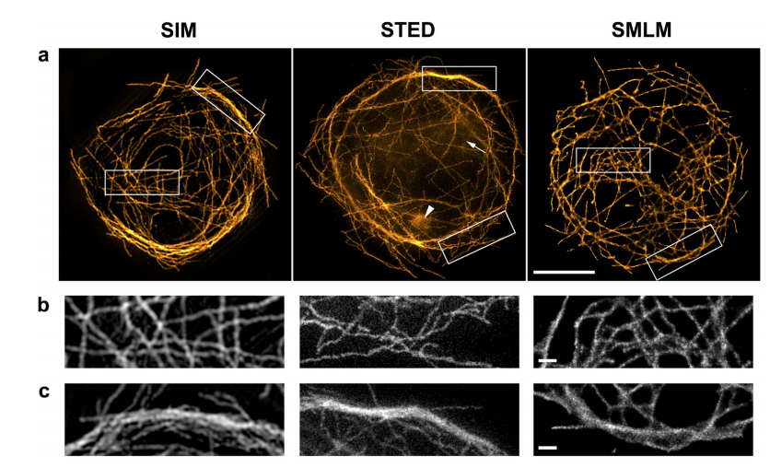
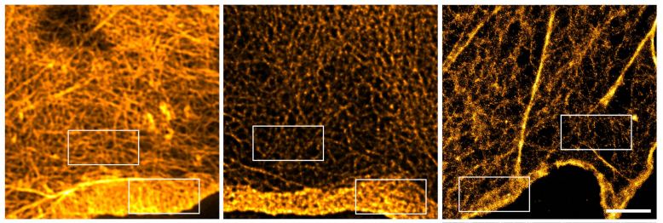
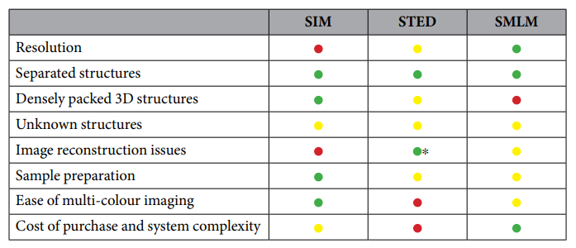
So, which one is the best?
Wegel, …, Dobbie, S.Rep. (2016) 6:27290
Notes:
Authors from Oxford, UK (Micron Oxford Advanced Imaging Unit)
cervena - nic moc
zluta - jakztakz
zelena - super!

Slide 25
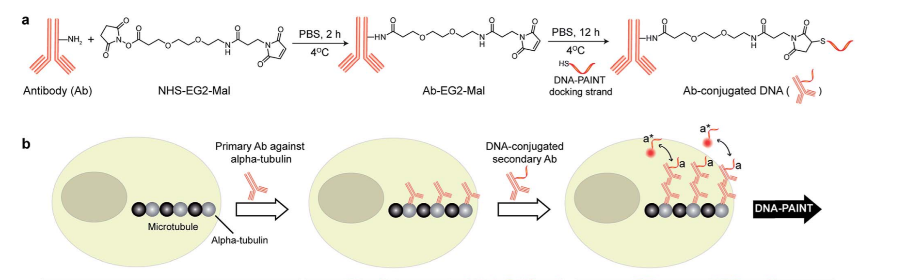
New strategy: DNA-PAINT
Transient binding of fluorescent probes
Based on DNA-DNA hybridization (good tunability, multicolor-compatible)
Various conjugation methods (biotin-streptavidin-biotin, NHS-xxx-Mal)
Problems with high background -> fluorogenic probes / confocal microscopy
Cy3b-modified oligonucleotide
(9-10 nt)
(Chem. Sci., 2017, 8, 3080–3091)
Notes:
relatively new, flexible method, works great in TIRF. Otherwise there are issues with background fluorescence.
Also, acquisition is slower than regular STORM...
further development of probes can be expected - 2020 - fluorogenic DNA-PAINT probes using dark quenchers - https://www.biorxiv.org/content/10.1101/2020.04.29.066886v1
DNA plave a nesviti a kdyz se prilepi na protilatku, tak se rozsvity…..najdi image

Slide 26
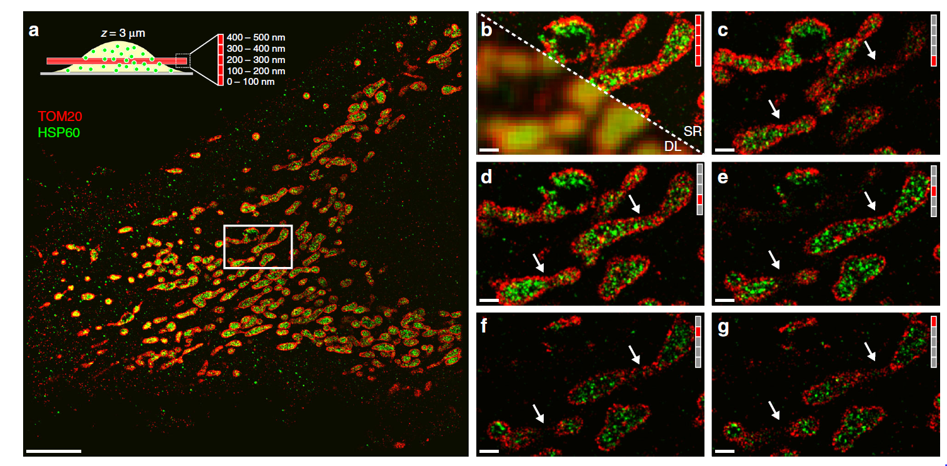
DNA-PAINT + spinning disk confocal combination
Acquisition ~ 1 h per plane !
Schueder et al, Nat. Comm., 8 (2017) 2090
Notes:
practically demonstrated resolution 20 x 20 x 80 nm, whole fixed cell in multiple colors, which is hard to achieve with STORM/PALM due to eventual bleaching of the fluorophores (here new fluorophores are supplied continuously)
Each channel imaged for several hours… The new fluorogenic probes (April 2020) should speed it up 25 times!

Slide 27
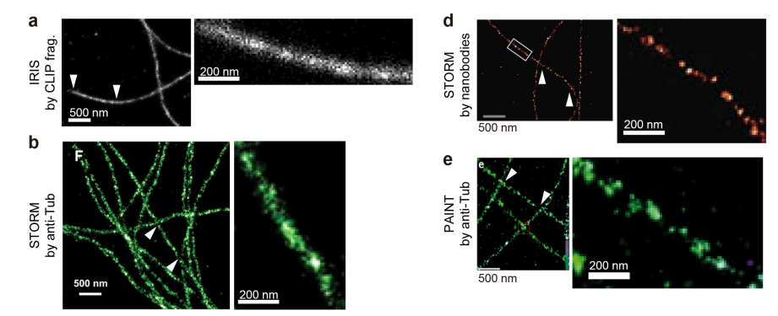
New strategy: IRIS
Transient binding of fluorescent probes
Based on weak protein-protein interactions
LifeAct, protein fragments
Solves the labeling density problem
Kikuchi et al, Nat. Meth., 12 (2015) 743
Notes:
relatively new, flexible method
further development of probes can be expected to fine-tune the bunding kinetics
Princip DNA paint, ale nepouziva se DNA, ale misto toho se pouzivaji specialni probes (proteiny, ktere se vazou slabe), proteinove frakmenty, ktere se vazi se spravnou afinitou) with weak, transient binding ( transient - vazi se jen prechodne na chvili a pak odleti)
- fluorescencni celou dobu a ja je vidim, az se zastavi….. zastavi se tim navazanim -----pak se rozvazou , nevidime je --- vypada jako blikani

Slide 28
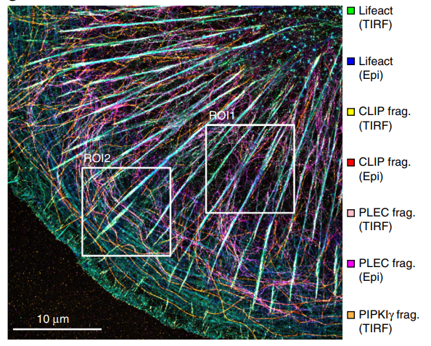
IRIS Application: Focal Adhesions
Multiple exchangeable probes in fixed cells
Oxygen scavenging buffer
20 – 400 min per channel
TIRF, widefield
Kikuchi et al, Nat. Meth., 12 (2015) 743
Notes:
(in fixed, permeabilized cells)
Since binding is transient, old probes can be washed away (microfluidics) and new probes introduces, so it is possible to image many different targets sequentially.

Slide 29


Fluorescent labeling
from Sahl et al, Nat Rev. Mol. Cel. Biol. 18 (2017) 685
Notes:
… again from the S+S+S review….
When pushing the resolution to 20 nm, the size of the fluorescent probe becomes important
researchers are more often trying something else than primary-secondary antibody pairs…
GFP is itself fluorescent, other proteins/peptides need to be conjugated to organic dyes
velikosti fluorescencnich proteinu jsou dulezite a porad se objevuji nove a nove metody, jak provezt znaceni

Slide 30
Summary and outlook
The hardware is more or less mature
Airyscan may see some upgrades
Superresolution with spinning disk confocal - optimization
Software keeps evolving
Image processing algorithms (AI is coming!)
Rapid development of new fluorescent probes
new labeling strategies, delivery into cells
fluorogenic probes, photoswitching, STED probes
live cell compatibility
faster imaging
Notes:
e.g. SNAP-SiR is a powerful tool for live cell imaging

Slide 31

Thank you
Hagen Lab @ LF1
Guy M. Hagen
Pavel Křížek
Martin Ovesný
Josef Borkovec
BioMT @ Dartmouth
Zdenek Svindrych
NIH: NIGMS COBRE award P20-GM113132
KONFMI @PrF UK
Ondrej Sebesta
Martin Schatz
Peter Hoboth

Slide 32



New strategy: Towards live cells
Already demonstrated with (PA-)GFPs
But organic dyes are better…
Transient permeabilization of cell membrane
e.g. Streptolysin O
GFP
Live U2OS cell, Teng et al., eLife 5 (2016) e20378
Live U2OS cell STORM, phalloidin-Alexa647,
4 mM glutathione + oxygen scavenger, 50 s averaging
Teng et al., eLife 5 (2016) e20378
Notes:
new attempts in live cell SMLM imaging, each subframe is 50 s average, showing splitting of actin filament bundle
STORM nba zivych bunkach –
pouziti – specialni fluorescencni proteiny, PAL

Slide 33


CCD
CL
improving resolution - more photons captured
Slit
Prism mirror
Slit
Objectives
Sample
Laser
Ke Xu et al., Nature Methods 9 (1012) 185 (Xiaowei Zhuang)

Slide 34
CCD
CL
improving resolution - more photons captured
Slit
Prism mirror
Slit
Objectives
Sample
Laser
Ke Xu et al., Nature Methods 9 (1012) 185 (Xiaowei Zhuang)

Slide 35


3D localization - astigmatism
y
x

Slide 36


Localisation in 3D - Biplane
camera plane is in xy – how to determine the z position?
bi-plane (multi-plane) imaging
information from two sections of the PSF
y
x
405 nm
Fiber-coupling Lens
Fiber-coupling Lens
488 nm
BCU
561 nm
Optical Fiber
AOTF
641 nm
Field Aperture
Defocused Plane
z
z
Tube Lens
x
x
EM-CCD Camera
Sample
Dichroic Mirror
Objective
Tube Lens
Dichroic Mirror
Filters
Beamsplitter Cube
Dichroic Mirror

Slide 37



Poor man’s Biplane

